Slide 1
An Introduction to Cloud Computing

Slide 2
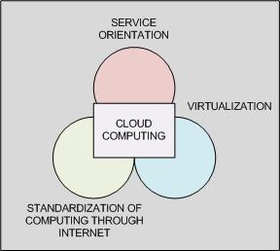
What is Cloud ?
Cloud computing is building a software system by utilization of services (software, hardware and people) already available in the internet / intranet. The need for cloud computing is to reduce cost and time to build the system as per the requirement. This can be achieved by several ways, including utilizing available resource at lower cost, by utilizing the application services available of the shelf rather than built it from scratch, and managing resources.
Notes:
Slide timing: 3-5 minutes
Instructor’s notes:
This diagram illustrates the typical technical infrastructure that underlies successful SOA implementations. Point out that the terminology here isn’t what’s important; “SOA Fabric” might be a “Service Network” or even an “Enterprise Service Bus.” Point out the difference between atomic Services and business Services. Also emphasize the business Service/business process loop that represents the ongoing composition of Services. Finally, direct attention to the governance and security infrastructure, which should interact with every part of the SOA infrastructure.
Key Concepts:
This diagram illustrates the typical technical infrastructure that underlies successful SOA implementations. Point out that the terminology here isn’t what’s important; “SOA Fabric” might be a “Service Network” or even an “Enterprise Service Bus.”
Point out the difference between atomic Services and business Services. Also emphasize the business Service/business process loop that represents the ongoing composition of Services. Finally, direct attention to the governance and security infrastructure, which should interact with every part of the SOA infrastructure.
Explain in detail what the Service Network and composition layers are
Show how SOA doesn’t remove the need for different technology layers
Explore how SOA is an abstraction and still requires ways to access business logic and data
Questions to Address:
What aspects of this infrastructure do you already have in place? What’s missing?
Why is security represented twice on this slide? (Put answer here)
Why are there two kinds of Services represented on this slide?

Slide 3
Cloud Computing – Focus Areas
Cloud Computing
Services On-Demand
Database On-Demand
Applications On-Demand
Platform On-Demand
Management/Governance-as-a-Service
Security-as-a-Service
Integration-as-a-Service
Application-as-a-Service
Process-as-a-Service
Platform-as-a-Service
Information-as-a-Service
Database-as-a-Service
Storage-as-a-Service
Infrastructure-as-a-Service

Slide 4
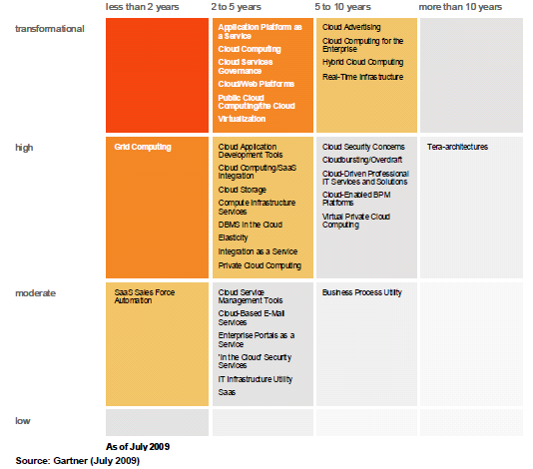
Gartner Priority Matrix for Cloud Computing
Notes:
Slide timing: 3-5 minutes
Instructor’s notes:
This diagram illustrates the typical technical infrastructure that underlies successful SOA implementations. Point out that the terminology here isn’t what’s important; “SOA Fabric” might be a “Service Network” or even an “Enterprise Service Bus.” Point out the difference between atomic Services and business Services. Also emphasize the business Service/business process loop that represents the ongoing composition of Services. Finally, direct attention to the governance and security infrastructure, which should interact with every part of the SOA infrastructure.
Key Concepts:
This diagram illustrates the typical technical infrastructure that underlies successful SOA implementations. Point out that the terminology here isn’t what’s important; “SOA Fabric” might be a “Service Network” or even an “Enterprise Service Bus.”
Point out the difference between atomic Services and business Services. Also emphasize the business Service/business process loop that represents the ongoing composition of Services. Finally, direct attention to the governance and security infrastructure, which should interact with every part of the SOA infrastructure.
Explain in detail what the Service Network and composition layers are
Show how SOA doesn’t remove the need for different technology layers
Explore how SOA is an abstraction and still requires ways to access business logic and data
Questions to Address:
What aspects of this infrastructure do you already have in place? What’s missing?
Why is security represented twice on this slide? (Put answer here)
Why are there two kinds of Services represented on this slide?

Slide 5
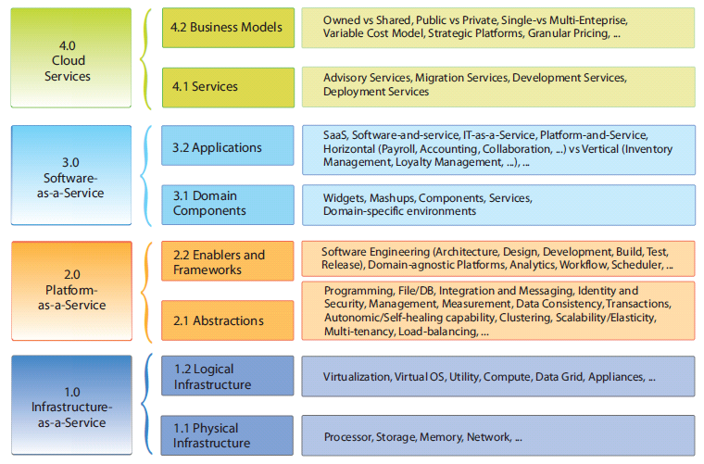
Cloud Taxonomy
source: TCS

Slide 6
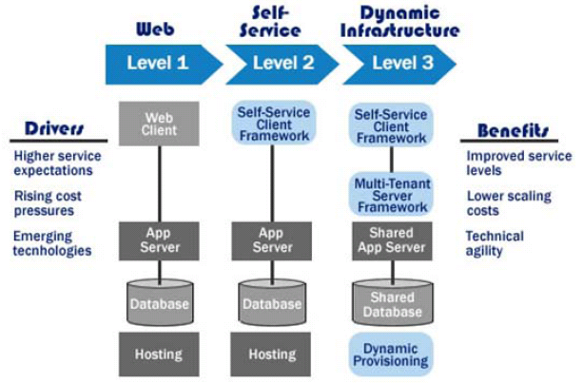
Cloud Roadmap
source: IBM

Slide 7
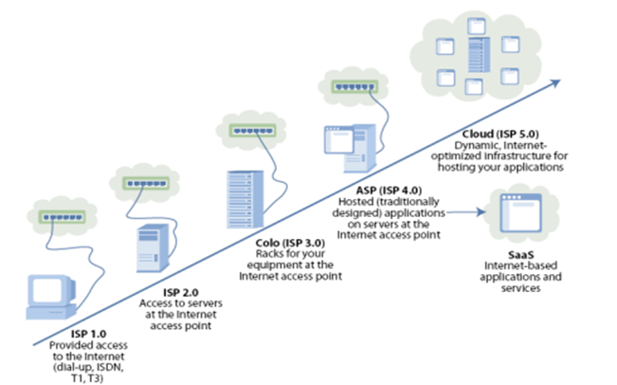
Cloud Computing- Latest Evolution in Hosting
Notes:
Slide timing: 3-5 minutes
Instructor’s notes:
This diagram illustrates the typical technical infrastructure that underlies successful SOA implementations. Point out that the terminology here isn’t what’s important; “SOA Fabric” might be a “Service Network” or even an “Enterprise Service Bus.” Point out the difference between atomic Services and business Services. Also emphasize the business Service/business process loop that represents the ongoing composition of Services. Finally, direct attention to the governance and security infrastructure, which should interact with every part of the SOA infrastructure.
Key Concepts:
This diagram illustrates the typical technical infrastructure that underlies successful SOA implementations. Point out that the terminology here isn’t what’s important; “SOA Fabric” might be a “Service Network” or even an “Enterprise Service Bus.”
Point out the difference between atomic Services and business Services. Also emphasize the business Service/business process loop that represents the ongoing composition of Services. Finally, direct attention to the governance and security infrastructure, which should interact with every part of the SOA infrastructure.
Explain in detail what the Service Network and composition layers are
Show how SOA doesn’t remove the need for different technology layers
Explore how SOA is an abstraction and still requires ways to access business logic and data
Questions to Address:
What aspects of this infrastructure do you already have in place? What’s missing?
Why is security represented twice on this slide? (Put answer here)
Why are there two kinds of Services represented on this slide?

Slide 8
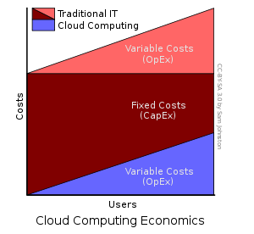
Cloud Computing Economics
Cloud computing users can avoid capital expenditure (CapEx) on hardware, software, and services when they pay a provider only for what they use. Consumption is usually billed on a utility (e.g., resources consumed, like electricity) or subscription (e.g., time-based, like a newspaper) basis with little or no upfront cost
Notes:
Slide timing: 3-5 minutes
Instructor’s notes:
This diagram illustrates the typical technical infrastructure that underlies successful SOA implementations. Point out that the terminology here isn’t what’s important; “SOA Fabric” might be a “Service Network” or even an “Enterprise Service Bus.” Point out the difference between atomic Services and business Services. Also emphasize the business Service/business process loop that represents the ongoing composition of Services. Finally, direct attention to the governance and security infrastructure, which should interact with every part of the SOA infrastructure.
Key Concepts:
This diagram illustrates the typical technical infrastructure that underlies successful SOA implementations. Point out that the terminology here isn’t what’s important; “SOA Fabric” might be a “Service Network” or even an “Enterprise Service Bus.”
Point out the difference between atomic Services and business Services. Also emphasize the business Service/business process loop that represents the ongoing composition of Services. Finally, direct attention to the governance and security infrastructure, which should interact with every part of the SOA infrastructure.
Explain in detail what the Service Network and composition layers are
Show how SOA doesn’t remove the need for different technology layers
Explore how SOA is an abstraction and still requires ways to access business logic and data
Questions to Address:
What aspects of this infrastructure do you already have in place? What’s missing?
Why is security represented twice on this slide? (Put answer here)
Why are there two kinds of Services represented on this slide?

Slide 9
Why Cloud Computing?
Scalability
Agility
Automation
Resource Sharing
Choice of Hybrid Option to utilize existing infrastructure
Automation of Complex Technologies
Reduction of Capital and Operational cost
Notes:
Slide timing: 3-5 minutes
Instructor’s notes:
This diagram illustrates the typical technical infrastructure that underlies successful SOA implementations. Point out that the terminology here isn’t what’s important; “SOA Fabric” might be a “Service Network” or even an “Enterprise Service Bus.” Point out the difference between atomic Services and business Services. Also emphasize the business Service/business process loop that represents the ongoing composition of Services. Finally, direct attention to the governance and security infrastructure, which should interact with every part of the SOA infrastructure.
Key Concepts:
This diagram illustrates the typical technical infrastructure that underlies successful SOA implementations. Point out that the terminology here isn’t what’s important; “SOA Fabric” might be a “Service Network” or even an “Enterprise Service Bus.”
Point out the difference between atomic Services and business Services. Also emphasize the business Service/business process loop that represents the ongoing composition of Services. Finally, direct attention to the governance and security infrastructure, which should interact with every part of the SOA infrastructure.
Explain in detail what the Service Network and composition layers are
Show how SOA doesn’t remove the need for different technology layers
Explore how SOA is an abstraction and still requires ways to access business logic and data
Questions to Address:
What aspects of this infrastructure do you already have in place? What’s missing?
Why is security represented twice on this slide? (Put answer here)
Why are there two kinds of Services represented on this slide?

Slide 10
Cloud – Key Characteristics
Incremental Scalability. Cloud environments allow users to access additional compute resources on-demand in response to increased application loads
Agility. As a shared resource, the cloud provides flexible, automated management to distribute the computing resources among the cloud's users.
Reliability and Fault-Tolerance. Cloud environments take advantage of the built-in redundancy of the large numbers of servers that make them up by enabling high levels of availability and reliability for applications that can take advantage of this
Cost is claimed to be greatly reduced and Capital Expenditure is converted to Operational Expenditure.
Device and location independence enable users to access systems using a web browser regardless of their location or what device they are using (e.g., PC, mobile). As infrastructure is off-site and accessed via the Internet, users can connect from anywhere
Multi-Tenancy enables sharing of resources and costs across a large pool of users thus allowing for
SLA-driven. Clouds are managed dynamically based on service-level agreements that define policies like delivery parameters, costs, and other factors.
Reliability improves through the use of multiple redundant sites, which makes cloud computing suitable for Business Continuity and Disaster Recovery.
Scalability via dynamic ("on-demand") provisioning of resources on a fine-grained, self-service basis near real-time, without users having to engineer for peak loads. Performance is monitored, and consistent and loosely-coupled architectures are constructed using Web Serivces as the system interface
Notes:
Slide timing: 3-5 minutes
Instructor’s notes:
This diagram illustrates the typical technical infrastructure that underlies successful SOA implementations. Point out that the terminology here isn’t what’s important; “SOA Fabric” might be a “Service Network” or even an “Enterprise Service Bus.” Point out the difference between atomic Services and business Services. Also emphasize the business Service/business process loop that represents the ongoing composition of Services. Finally, direct attention to the governance and security infrastructure, which should interact with every part of the SOA infrastructure.
Key Concepts:
This diagram illustrates the typical technical infrastructure that underlies successful SOA implementations. Point out that the terminology here isn’t what’s important; “SOA Fabric” might be a “Service Network” or even an “Enterprise Service Bus.”
Point out the difference between atomic Services and business Services. Also emphasize the business Service/business process loop that represents the ongoing composition of Services. Finally, direct attention to the governance and security infrastructure, which should interact with every part of the SOA infrastructure.
Explain in detail what the Service Network and composition layers are
Show how SOA doesn’t remove the need for different technology layers
Explore how SOA is an abstraction and still requires ways to access business logic and data
Questions to Address:
What aspects of this infrastructure do you already have in place? What’s missing?
Why is security represented twice on this slide? (Put answer here)
Why are there two kinds of Services represented on this slide?

Slide 11
Cloud Offerings at the Peak
Elasticity
Cloud service elasticity is the ability to increase or decrease the amount of system capacity (for example, CPU, storage, memory and input/output [I/O] bandwidth) that is available to a given cloud service on demand in an automated fashion
Amazon, Enomaly, salesforce.com, VMware
Enterprise Portals as a Service
Portal-as-a-service offering is a horizontal enterprise portal delivered via software as a service (SaaS) to multiple client enterprises from the same, multitenant architecture
Covisint, Microsoft
Cloud/Web Platforms
Cloud/Web platforms use Web technologies to provide programmatic access to functionality on the Web, including capabilities enabled not only by technology but also by community and business aspects - storage and computing power
Web-oriented architecture (WOA) interfaces, such as representational state transfer (REST), plain old XML (POX) and Really Simple Syndication (RSS). In addition to the capabilities of Web 2.0, these platforms provide programmatic access to cloud-computing capabilities.
Amazon, Google, Microsoft, salesforce.com
Source: Gartner 2009 Hype Cycle Data

Slide 12
Cloud Offerings at the Peak
Compute Infrastructure Services
On-demand computing capacity from a service provider
Amazon, Rackspace, ServePath
'In the Cloud' Security Services
Internet-fabric-based managed firewalls, intrusion detection systems, intrusion prevention systems, antivirus services, distributed denial-of-service protection services, messaging security and Web gateway security services
Savvis, MessageLabs, Perimeter Internetworking, Prolexic Technologies, Purewire, Qualys, Savvis, ScanSafe, Verizon Business, Webroot, Websense, WhiteHat Security, Zscaler
Cloud Computing
Style of computing where scalable and elastic IT-enabled capabilities are delivered as a service to external customers using Internet technologies
Amazon.com; Google; Microsoft; salesforce.com
Public Cloud Computing/the Cloud
Style of computing where scalable and elastic IT-enabled capabilities are provided "as a service" to external customers using Internet technologies
Flickr, Facebook
Source: Gartner 2009 Hype Cycle Data

Slide 13
Cloud Computing Issues
Security
Are my business transactions and user information safe?
Data
Is my data safe? Is it recoverable within an acceptable time frame? Is it portable?
Is it located in a region that I'm comfortable with?
Reliability
Will the service be available when I need it? Are the service-level agreements (SLAs) acceptable, and are they being met?
Cost
Are the promised cost savings being realized?
Integration
How will I integrate my on-premises services with cloud-based services?
How will I integrate multiple cloud-based services with each other?
End-to-end process control
How will I control my business process when a mix of on premises and cloud-based services is involved?
Vendor
Is the vendor going to survive the eventual industry consolidation? Is the vendor trustworthy? Is there a possibility of vendor lock-in?
Culture
Can IT adjust to not owning the computing resources and people necessary to provide services to their customers?
Source: Gartner

Slide 14
Typical Applications for Cloud Computing
Compute Intensive
Simulation, computation and analysis
Stored media streaming distribution (e.g. pod-cast)
Ad-hoc computer power for analytics (e.g. e-Discovery)
Digitalization of media, Real-time media streaming
Content Delivery
Search Engine
Backup and Storage
Domain Focused
Electronic payment platform for Financial Services
Supply and distribution for transportation
Financial simulations, risk management and/or compliance applications
Securities extranet services for financial services
Collaborative R&D environment for manufacturing/pharmaceutical
Electrical Medical Record exchange platform for healthcare
Channel integration and customer management for Retail
e-Procurement and e-Commerce
Gaming platforms

Slide 15
Cloud Platforms Comparison
 | Amazon | Google | Force.com | Microsoft
Cloud Offering | EC2 | Google App Engine | Force.com | Azure
Description | Collection of remote computing services (also called web services) offered over the Internet | Platform for developing and hosting web applications in Google-managed data centers | Force.com as a platform exposes set of integrated of tools and services to build applications and run on the same infrastructure that delivers the current Salesforce CRM applications | Internet-scale cloud services platform hosted in Microsoft data centers, which provides an operating system and a set of developer services that can be used individually or together
Cloud Service Types | IaaS, SaaS | IaaS, SaaS, PaaS | IaaS, SaaS, PaaS | SaaS, PaaS
Services | Only Infrastructure Services | Cloud platform but lacks enterprise capabilities | Complete, state-of-the-art PaaS; large variety of Enterprise applications including CRM and ERP already available Close partnership with Google | Most complete offerings, has all the offerings
Target Users | Individual User, Enterprise Customers | Mostly Individual Users | Enterprise Customers, SME Large installed base with big scale enterprise users | Enterprise Customers
Target Applications | Not Applicable | Only Web Applications | Web, full range of Enterprise applications like ERP, CRM | Web, Windows, CRM, CMS
Stability | One of the most mature solutions in the market today | Google App Engine is a very web-server-centric offering perfect to develop server-side applications. It is based on the experince from Google in developing and managing large scale web deployments | Force.com exploits the established and widely used Salesforce.com application architecture Big scale users like Japan Post (65000 users) | Azure is evolving and in CTP. Microsoft supports Azure Storage, Compute, SQL Azure (full-blown SQL Server database) and .Net Services. In future, they intend to support SharePoint and CRM services
Scalability and Failover | Supports Auto Scaling/Provisioning | Supports Auto Scaling/Provisioning | Supports Auto Scaling/Provisioning | Supports some Auto Failover/Scale (but needs declarative application properties)
Site Monitoring | Amazon CloudWatch Service | Hyperic CloudStatus Service | Force.com Site Usage managed package | Azure Platform Services

Slide 16
Cloud Platforms Comparison
 | Amazon | Google | Force.com | Microsoft
Development Platform | None. Amazon runs virtual machines and does not care which development platform is used | Provides support for basic editing, local simulation, and deployment tools with plug-ins for Eclipse IDE | Provides a component-based user interface framework . Visualforce can be utilized for rich UI development - it also allows use of JavaScript, AJAX and Flex. | Integration into Visual Studio IDE
Languages supported | Not Applicable | Python/Java | Apex | .Net/PHP
Storage support | Simple Storage Service (S3) and SimpleDB | BigTable, Datastore APIs | Force.com open standard Database APIs | Azure Storage and SQL Azure
Messaging and Queuing support | Simple Queue Service (SQS) | Not supported | Not supported | Azure SDK
Workflow support | Not supported | Not supported | Force.com's workflow and approvals engine | .NET Framework 4.0
Service Integration support | None | None | Services can be build using APEX and exposed for integration | .Net Service Bus
On-premise Integration | No support from vendor. Developers can still build custom integration solutions | None | Developers can build custom integration solutions. In addition, Appexchange has partner developed apps for integration. | .NET Service Bus enables to integrate on-premise services with ease
Commercial Availability | Commercially Available | Open for public use (beta) | Commercially Available | CTP phase, commercial launch likely in 2009
Pricing | 10 cents/hour for small instance of AMI (1.7GB memory/160GB storage), 15 cents/GB storage, and 10-17 cents per GB data transfer | 5 million page views free. After that, 10-12 cents/hour of a CPU core, 15-18 cents/GB storage and 9-13 cents for per GB data transfer | Free Developer Accounts (for developer community) For customers/prospects 1 free application with upto 100 free users and 1 GB storage Enterprise Edition - $50/user/month Unlimited Edition - $75/user/month | Compute = $0.12/hour Storage = $0.15/GB stored Storage Transactions = $0.01/10K Bandwidth = $0.10 in/$0.15 out/GB

Slide 17
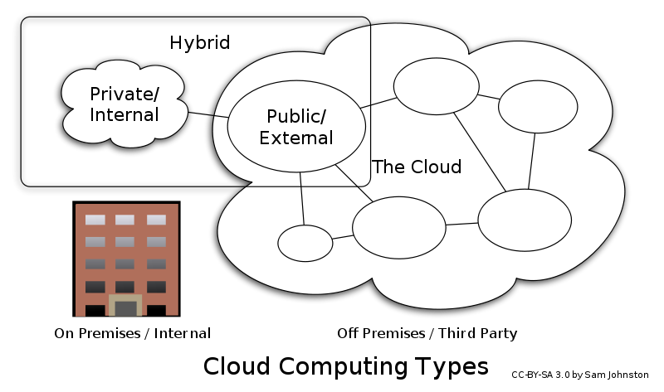
Types of cloud
Public cloud or external cloud describes cloud computing in the traditional mainstream sense, whereby resources are dynamically provisioned on a fine-grained, self-service basis over the Internet, via web applications/web services, from an off-site third-party provider who shares resources and bills on a fine-grained utility computing basis
A hybrid cloud environment consisting of multiple internal and/or external providers "will be typical for most enterprises
Private cloud and internal cloud have been used to describe offerings that emulate cloud computing on private networks. These (typically virtualization automation) products claim to "deliver some benefits of cloud computing without the pitfalls", capitalizing on data security, corporate governance, and reliability concerns. Users still have to buy, build, and manage them and do not benefit from lower up-front capital costs and less hands-on management, essentially lacking the economic model that makes cloud computing such an intriguing concept
Notes:
Slide timing: 3-5 minutes
Instructor’s notes:
This diagram illustrates the typical technical infrastructure that underlies successful SOA implementations. Point out that the terminology here isn’t what’s important; “SOA Fabric” might be a “Service Network” or even an “Enterprise Service Bus.” Point out the difference between atomic Services and business Services. Also emphasize the business Service/business process loop that represents the ongoing composition of Services. Finally, direct attention to the governance and security infrastructure, which should interact with every part of the SOA infrastructure.
Key Concepts:
This diagram illustrates the typical technical infrastructure that underlies successful SOA implementations. Point out that the terminology here isn’t what’s important; “SOA Fabric” might be a “Service Network” or even an “Enterprise Service Bus.”
Point out the difference between atomic Services and business Services. Also emphasize the business Service/business process loop that represents the ongoing composition of Services. Finally, direct attention to the governance and security infrastructure, which should interact with every part of the SOA infrastructure.
Explain in detail what the Service Network and composition layers are
Show how SOA doesn’t remove the need for different technology layers
Explore how SOA is an abstraction and still requires ways to access business logic and data
Questions to Address:
What aspects of this infrastructure do you already have in place? What’s missing?
Why is security represented twice on this slide? (Put answer here)
Why are there two kinds of Services represented on this slide?

Slide 18
Considerations for moving from On Premise to Public Cloud
On Premise To Cloud
High Low Low High
Seasonal and Unpredictable Demand
Upfront Costs (High Licensing and Infrastructure costs)
Scalability (On-demand Scalability and Auto Provisioning)
High Availability (Cloud better equipped for Fault Tolerance)
Large Storage (Processing, Backup and archival of Large data)
High-Computing (Cloud and Grid in a scalable environment)
Administration Overhead (Self Service and Managed Services)
Pay per Use (Avoid upfront investment)
Application Criticality
Technical Feasibility and Migration Costs
Compliance and Security (including Data Security)
Overall TCO Savings (compared to On-Premise)

Slide 19
Considerations for deciding Private Cloud over Public Cloud
Private Cloud Public Cloud
High Low Low High
Upfront Costs (High Licensing and Infrastructure costs)
Application Criticality
Compliance and Security (including Data Security)
Tighter Access Control (Data and Resources)
Administration Overhead
Technical Feasibility and Migration Costs

Slide 20
Introduction to EC2
A presentation from IBG MCS, Solutions Team

Slide 21
Agenda
Introduction to EC2
Security Group
Elastic IP
Practical demo to Managing EC2 Instance

Slide 22
Introduction to EC2
Amazon Elastic Compute Cloud (Amazon EC2) is a web service that provides resizable computing capacity—literally, servers in Amazon's data centers—that you use to build and host your software systems.
You can access the components and features that EC2 provides using a web-based GUI, a command line interface, and APIs.
AMI
An Amazon Machine Image (AMI) is a template that contains a software configuration (for example, an operating system, an application server, and applications).
From an AMI, you launch instances, which are copies of the AMI running as virtual servers in the cloud.
You can launch multiple instances of an AMI, as shown in the following figure.

Slide 23
Security Group
A security group acts as a firewall that controls the traffic allowed to reach one or more instances. When you launch an EC2 instance, you associate it with one or more security groups. You can add rules to each security group that control the inbound traffic allowed to reach the instances associated with the security group.
You can modify rules for a security group at any time.
The new rules are automatically applied to all instances associated with the security group.
Security groups are specific to the region they are created in and can only be applied to instances in the same region.
Default Security Group
Allow no inbound traffic
Allow all outbound traffic
Allow instances associated with this security group to talk to each other

Slide 24
Elastic IP
Elastic IP address (EIP) is a static IP address designed for dynamic cloud computing. With an EIP, you can mask the failure of an instance by rapidly remapping the address to another instance.
Your EIP is associated with your AWS account, not a particular instance, and it remains associated with your account until you choose to explicitly release it.

Slide 25
Thank you

